Slide 1
Cryptography and Network Security
Third Edition
by William Stallings
Lecture slides by Lawrie Brown

Slide 2
The need...
In CERTs 2001 annual report it listed 52,000 security incidents
the most serious involving:
  IP spoofing
    intruders creating packets with false address then taking advantages of OS exploits
  eavesdropping and sniffing
    attackers listen for userids and passwords and then just walk into target systems
  as a result the IAB included authentication and encryption in the next generation IP (IPv6)

Slide 3
IP Security
We’ve considered some application specific security mechanisms
  eg. S/MIME, PGP, Kerberos, SSL/HTTPS
however there are security concerns that cut across protocol layers
would like security implemented by the network for all applications

Slide 4
IPSec
general IP Security mechanisms
provides
  authentication
  confidentiality
  key management
applicable to use over LANs, across public & private WANs, & for the Internet

Slide 5
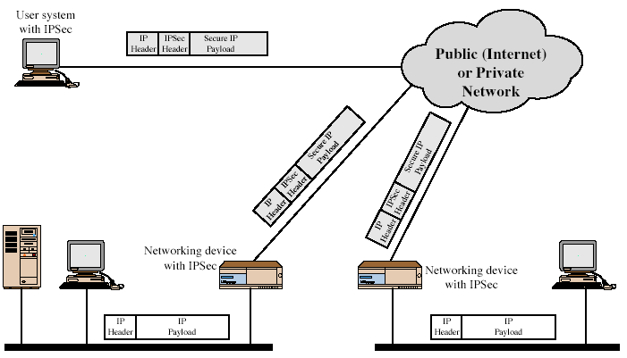
IPSec Uses
Notes:
Stallings Fig 16-1.

Slide 6
Benefits of IPSec
in a firewall/router provides strong security to all traffic crossing the perimeter
is resistant to bypass
is below transport layer, hence transparent to applications
can be transparent to end users
can provide security for individual users if desired
additionally in routing applications:
  assure that router advertisments come from authorized routers
  neighbor advertisments come from authorized routers
  insure redirect messages come from the router to which initial packet was sent
  insure no forging of router updates

Slide 7
IP Security Architecture
RFC 2401 (Primary RFC)
specification is quite complex
defined in numerous RFC’s
  incl. RFC 2401/2402/2406/2408
  many others, grouped by category
mandatory in IPv6, optional in IPv4

Slide 8
IPSec Services
Two protocols are used to provide security:
  Authentication Header Protocol (AH)
  Encapsulation Security Payload (ESP)
Services provided are:
  Access control
  Connectionless integrity
  Data origin authentication
  Rejection of replayed packets
    a form of partial sequence integrity
  Confidentiality (encryption)
  Limited traffic flow confidentiality

Slide 9
Security Associations
a one-way relationship between sender & receiver that affords security for traffic flow
identified by 3 parameters:
  Security Parameters Index (SPI)
    a bit string
  IP Destination Address
    only unicast allowed
    could be end user, firewall, router
  Security Protocol Identifier
    indicates if SA is AH or ESP
has a number of other parameters
  seq no, AH & EH info, lifetime etc
have a database of Security Associations

Slide 10
Authentication Header (AH)
RFC 2402
provides support for data integrity & authentication of IP packets
  end system/router can authenticate user/app
  prevents address spoofing attacks by tracking sequence numbers
based on use of a MAC (message authentication code)
  HMAC-MD5-96 or HMAC-SHA-1-96
  MAC is calculated:
    immutable IP header fields
    AH header (except for Authentication Data field)
    the entire upper-level protocol data (immutable)
parties must share a secret key

Slide 11
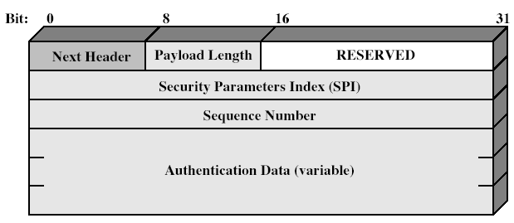
Authentication Header
Notes:
Stallings Fig 16-3.

Slide 12
Transport and Tunnel Modes
Both AH and ESP have two modes
  transport mode is used to encrypt & optionally authenticate IP data
    data protected but header left in clear
    can do traffic analysis but is efficient
    good for ESP host to host traffic
  tunnel mode encrypts entire IP packet
    add new header for next hop
    good for VPNs, gateway to gateway security

Slide 13
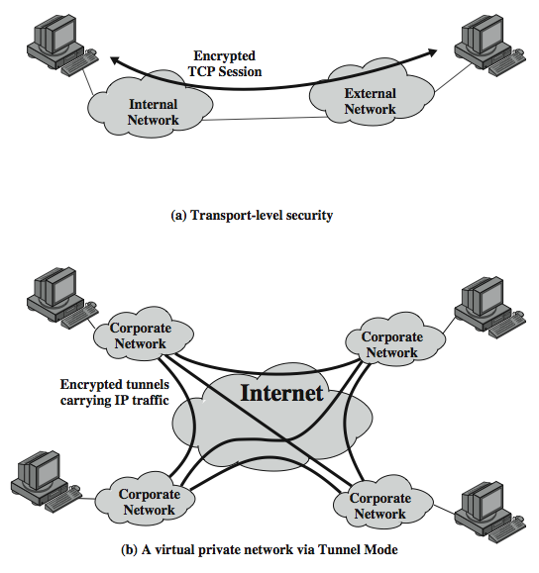
Transport & Tunnel Modes
Notes:
Stallings Fig 16-5.

Slide 14
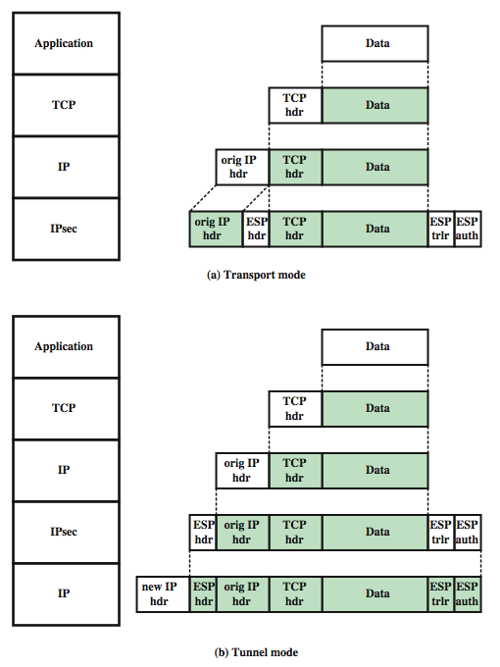
Transport & Tunnel Modes
Notes:
Stallings Fig 16-5.

Slide 15
Encapsulating Security Payload (ESP)
RFC 2406
provides message content confidentiality & limited traffic flow confidentiality
can optionally provide the same authentication services as AH
supports range of ciphers, modes, padding
  incl. DES, Triple-DES, RC5, IDEA, CAST etc
  CBC most common
  pad to meet blocksize, for traffic flow

Slide 16
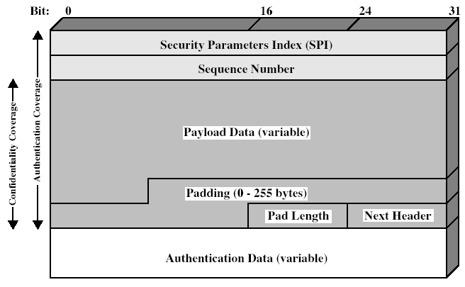
Encapsulating Security Payload
Notes:
Stallings Fig 16-7.

Slide 17
Combining Security Associations
SA’s can implement either AH or ESP
to implement both need to combine SA’s
  form a security bundle
have 4 cases (see next)

Slide 18
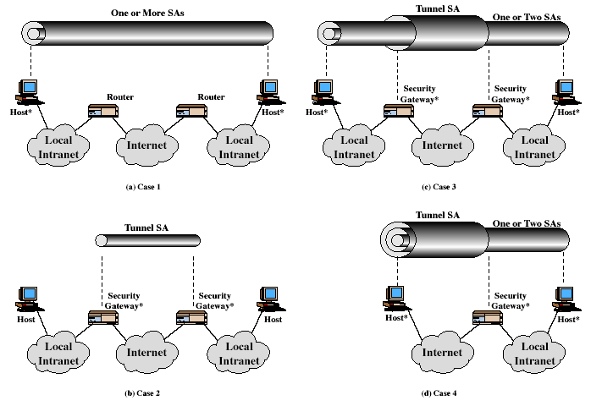
Combining Security Associations
a. AH in transport mode
b.ESP in transport mode
c. AH followed by ESP in transport mode(ESP SA inside an AH SA
d. any one a, b, c inside an AH or ESP in tunnel mode
Notes:
Stallings Fig 16-10.

Slide 19
Key Management
handles key generation & distribution
typically need 2 pairs of keys
  2 per direction for AH & ESP
manual key management
  sysadmin manually configures every system
automated key management
  automated system for on demand creation of keys for SA’s in large systems
  has Oakley & ISAKMP elements

Slide 20
Oakley
RFC 2412
a key exchange protocol
based on Diffie-Hellman key exchange
adds features to address weaknesses
  cookies, groups (global params), nonces, DH key exchange with authentication
can use arithmetic in prime fields or elliptic curve fields

Slide 21
ISAKMP
Internet Security Association and Key Management Protocol (RFC 2407)
provides framework for key management
defines procedures and packet formats to establish, negotiate, modify and delete SAs
independent of key exchange protocol, encryption algorithm and authentication method

Slide 22
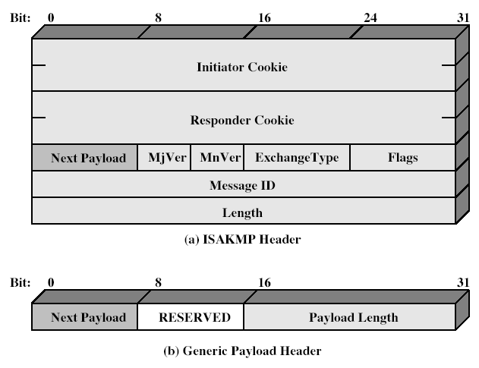
ISAKMP
Notes:
Stallings Fig 16-12.

Slide 23
Summary
have considered:
  IPSec security framework
  AH Protocol
  ESP Protocol
  key management & Oakley/ISAKMP

